Slide 1
Chapter 16
Simultaneous Equations Models

Slide 2
Simultaneous Equations Models (1 of 14)
Simultaneity is another important form of endogeneity
Simultaneity occurs if at least two variables are jointly determined.
A typical case is when observed outcomes are the result of separate behavioral mechanisms that are coordinated in an equilibrium.
The prototypical case is a system of demand and supply equations:
D(p) = how high would demand be if the price was set to p?
S(p) = how high would supply be if the price was set to p?
Both mechanisms have a ceteris paribus interpretation.
Observed quantity and price will be determined in equilibrium.
Simultaneous equations systems can be estimated by 2SLS/IV

Slide 3
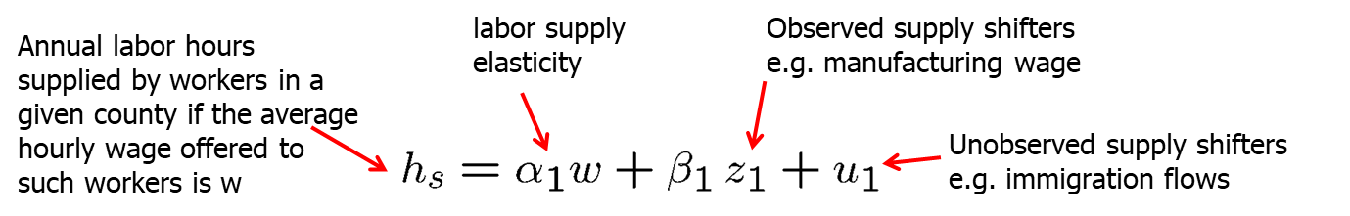
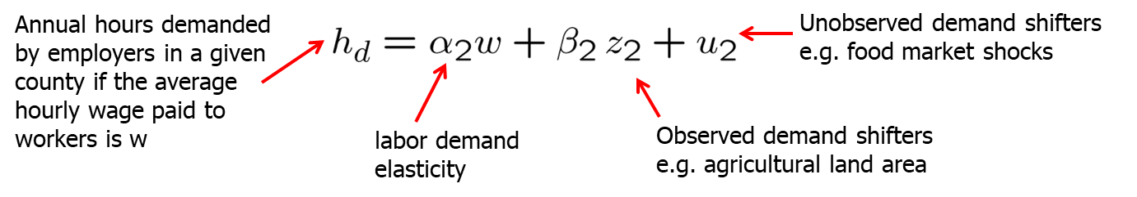
Simultaneous Equations Models (2 of 14)
Example: Labor demand and supply in agriculture

Slide 4
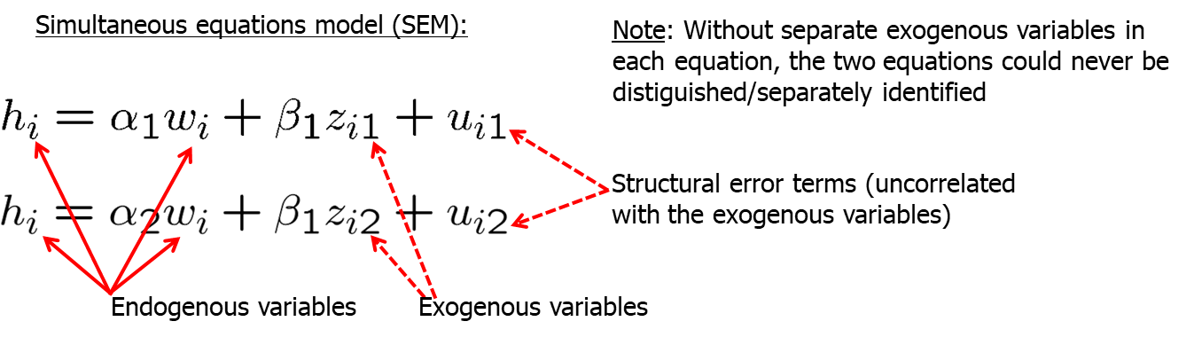
Simultaneous Equations Models (3 of 14)
Example: Labor demand and supply in agriculture (cont.)
Competition on the labor market in each county i will lead to a county wage w_{i} so that the total num-ber of hours h_{is} supplied by workers in this county equals the total number of hours h_{id} demanded by agricultural employers in this county:

Slide 5
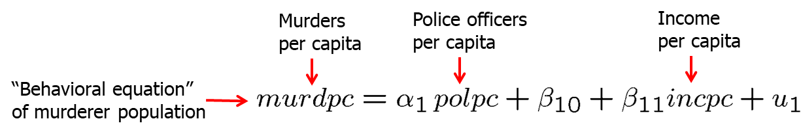
Simultaneous Equations Models (4 of 14)
Example: Murder rates and the size of the police force
polpc will not be exogenous because the number of police officers will dependent on how high the murder rate is (“reverse causation”).
The interesting equation for policy purposes is the first one. City governments will want to know by how much the murder rate decreases if the number of police officers is exogenously increased. This will be hard to measure because the number of police officers is not exogenously chosen (it depends on how much crime there is in the city, see second equation).

Slide 6
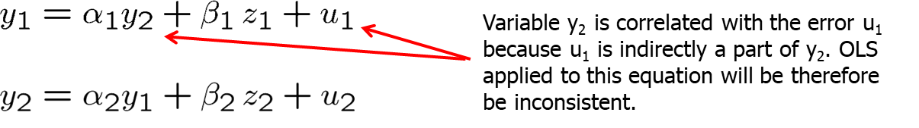
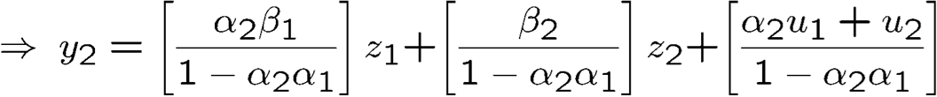
Simultaneous Equations Models (5 of 14)
Simultaneity bias in OLS
Insert the first equation into the second

Slide 7
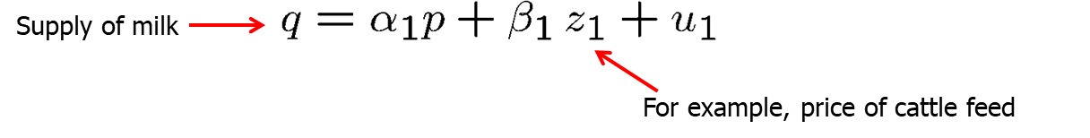
Simultaneous Equations Models (6 of 14)
Identification in simultaneous equations systems
Example: Supply and demand system
Which of the two equations is identified?
The supply function cannot be consistently estimated because one of the regressors is endogenous and we do not have an instrument.
The demand function can be consistently estimated because we can take z₁ as an instrument for the endogenous price variable.

Slide 8
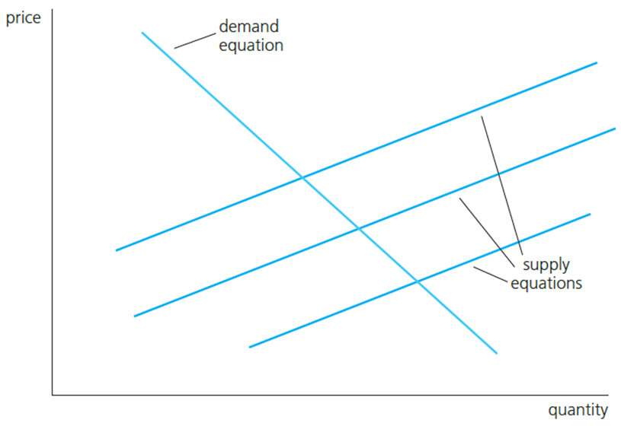
Simultaneous Equations Models (7 of 14)
Graphical illustration of identification problem
Intuitively, it is clear why the demand equation can be identified:
We have an observed variable z₁ that shifts the supply equation while not affecting the demand equation.
In this way the demand equation can be traced out.

Slide 9
Simultaneous Equations Models (8 of 14)
General rules for identification in simultaneous equation systems
Order condition
A necessary condition for the first equation to be identified is that at least one of all exogenous variables is excluded from this equation.
Rank condition
The first equation is identified if, and only if, the second equation contains at least one exogenous variable that is excluded from the first equation.

Slide 10
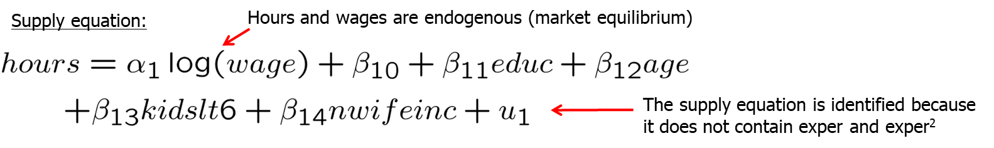
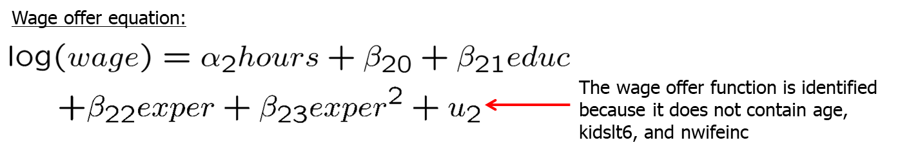
Simultaneous Equations Models (9 of 14)
Example: Labor supply of married, working women

Slide 11
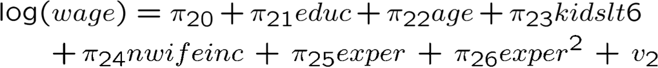
Simultaneous Equations Models (10 of 14)
Example: Labor supply of married, working women (cont.)
The rank condition, i.e. the condition that exogenous variables excluded from the equation are included in the other equation can be tested using reduced form equations.
Note that this equation can be consistently estimated by OLS as it contains only exogenous variables.
The same argument applies to the identification of the wage offer function.

Slide 12
Simultaneous Equations Models (11 of 14)
Estimation of simultaneous equation systems by 2SLS
Given the identification condition holds, the parameters of a simultaneous equations system can be consistenly estimated by 2SLS.
For this, in a first stage, each endogenous variable is regressed on the full list of exogenous variables (reduced form regressions).
In a second stage, the system equations are estimated by OLS but with the endogenous regressors being replaced by predictions from stage one.
If not all equations are identified, one can estimate only the identified ones.
If certain additional conditions hold, one can also use more efficient system estimation methods (Three Stage Least Squares, 3SLS).

Slide 13
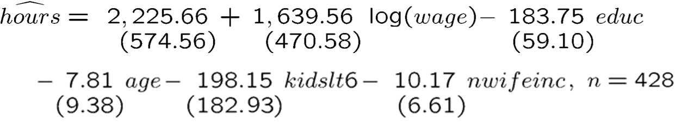
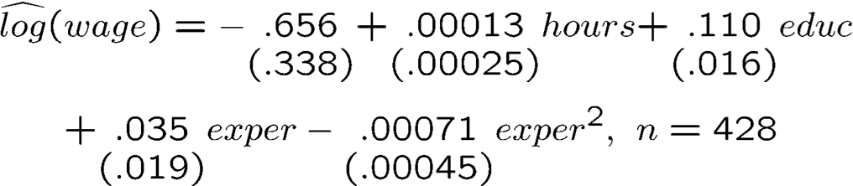
Simultaneous Equations Models (12 of 14)
Example: Labor supply of married, working women using 2SLS

Slide 14
Simultaneous Equations Models (13 of 14)
Systems with more than two equations
A necessary condition for identification of an equation is that there are more excluded exog. var. than endog. regressors (= order condition).
There is also a rank condition (but it is much more complicated).
Simultaneous equations models with time series
Among the earliest applications of SEMs was the estimation of large systems of simultaneous equations for macroeconomic time series.
For a number of reasons, such systems are seldom estimated now.
The main problem is that most time series are not weakly dependent.
Another problem is the lack of enough exogenous variables.

Slide 15
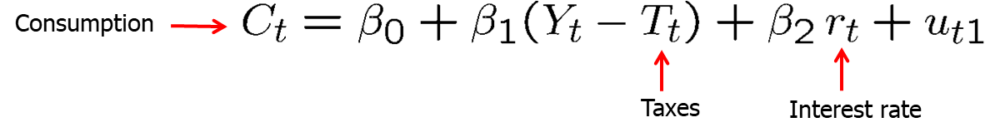
Simultaneous Equations Models (14 of 14)
Example: A simple Keynesian model of aggregate demand

